Slide 1

BAPUJI INSTITUE OF ENGINEERING AND TECHNOLOGY DBMS MINI PROJECT ON “EMPLOYEE PAYROLL MANAGEMENT SYSTEM”
PROJECT GUIDES:
Dr. GURURAJ T _{M.Tech.,}
Assistant Professor
CHANDRASHEKAR M V M.Tech.,
Assistant Professor
PROJECT ASSOSIATES:
DARSHAN A HIREMATH
4BD20CS124
JEVEEN H K
4BD20CS040

Slide 2
CONTENTS
ABSTRACT
INTRODUCTION
SYSTEM REQUIRMENTS AND SPECIFICATION
IMPLIMENTATION
E R DIAGRAM
SNAPSHOTS
CONCLUSION
REFRENCES

Slide 3
ABSTRACT
"Employee Database and Payroll Management System" is designed to make the existing manual system automatic with the help of computerized equipment and full-edged computer software, fulfilling their requirements, so that their valuable data and information can be stored for a longer period with easy access and manipulation of the same. The required software is easily available and easy to work with. This web application can maintain and view computerized records without getting redundant entries. The project describes how to manage user data for good performance and provide better services for the client.

Slide 4
INTRODUCTION
This project mainly focuses on managing all employee’s financial records in a simple and automated fashion. This payroll management system manages the employee’s salaries,deductions,other conveyance,net pay,bonuses and generation of payslips, etc.and this has been developed to overcome the problems faced in the practicing of manual system.

Slide 5
SOFTWARE REQUIREMENTS
The software required for the development of this project is:
1. Software : XAMPP
2. Operating System : Windows 7 (and other higher version)
3. Front End :HTML, CSS
4. Programming Language : PHP
5. Database Environment : MySQL and PhpMyAdmin
6. Server : APACHE

Slide 6
HARDWARE REQUIREMENTS
The hardware required for the development of this project is :
1. Processor : Intel Core i5
2. Processor speed :1.7 GHz
3. RAM :4 GB RAM
4. System Type :32/ 64-Bit Operating System

Slide 7
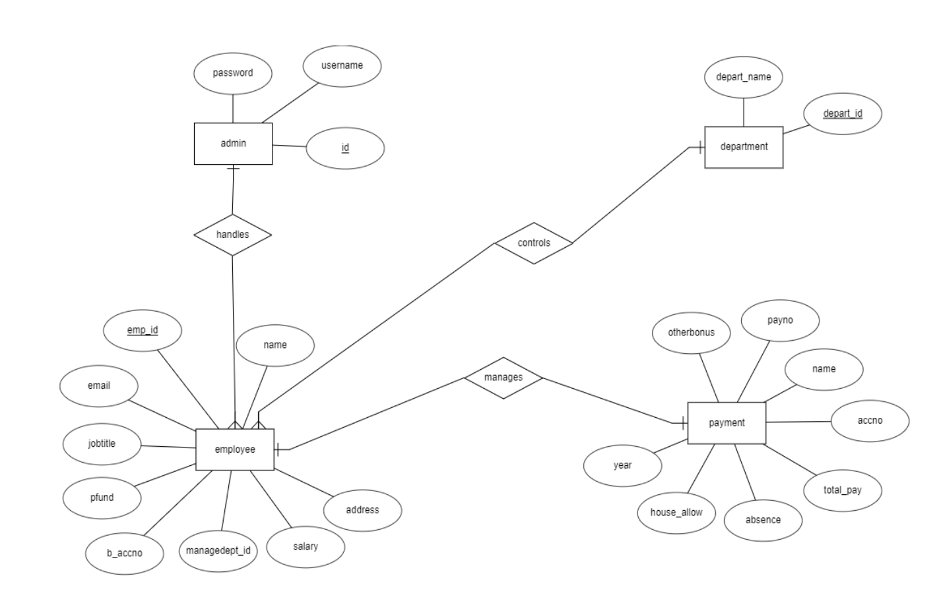
E R DIAGRAM

Slide 8
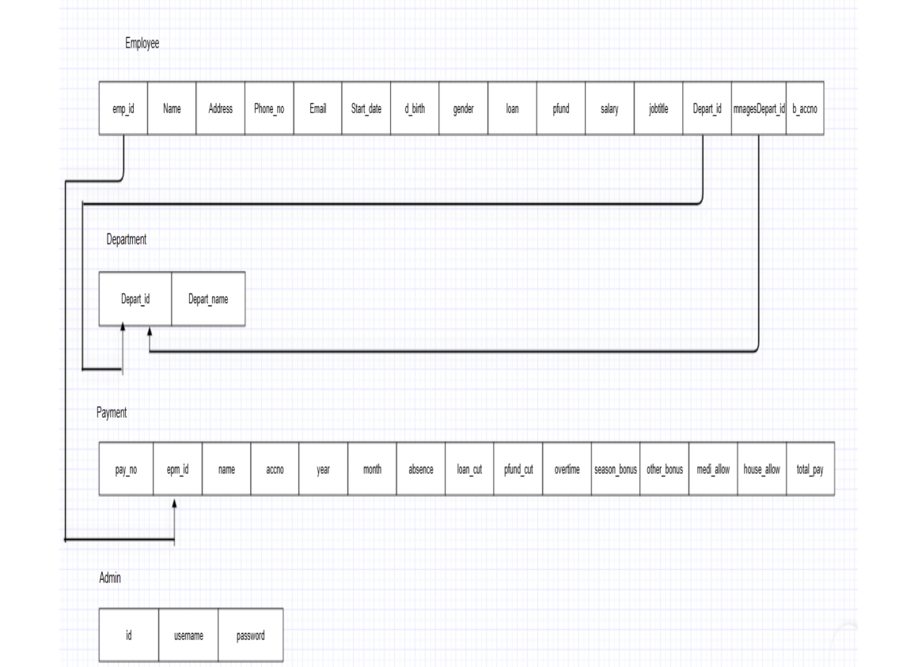
SCHEME DIAGRAM

Slide 9
SNAP SHOTS

Slide 10
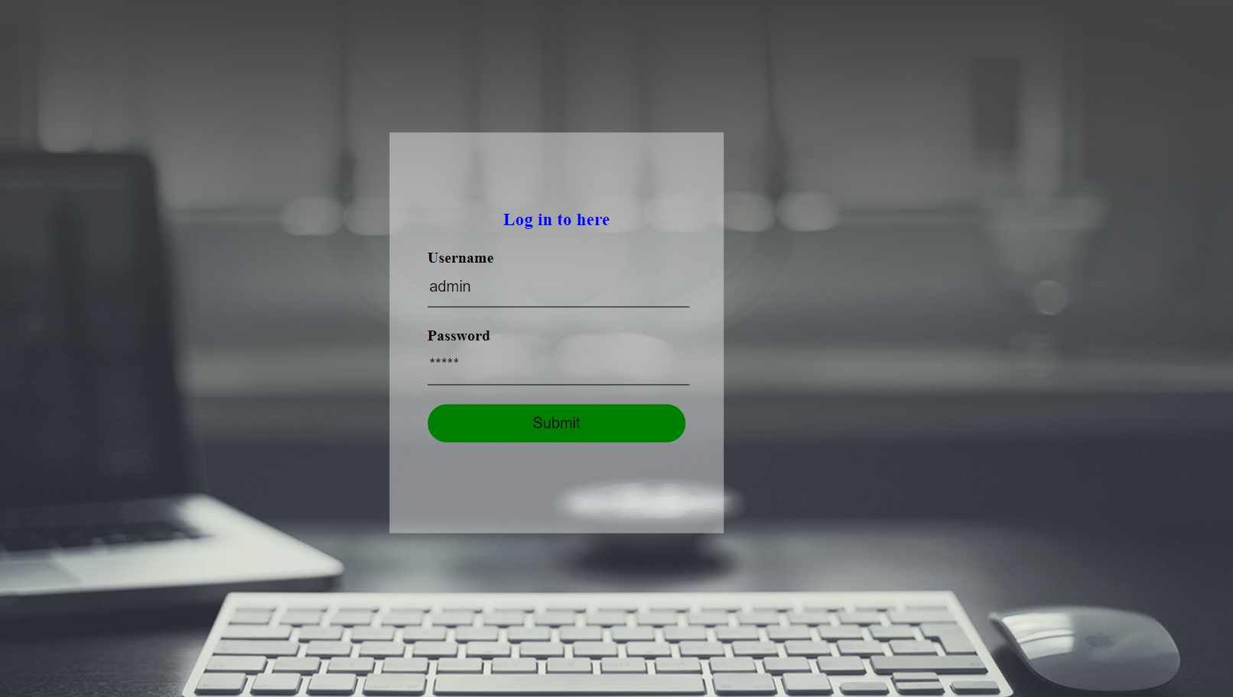
ADMIN LOGIN PAGE

Slide 11
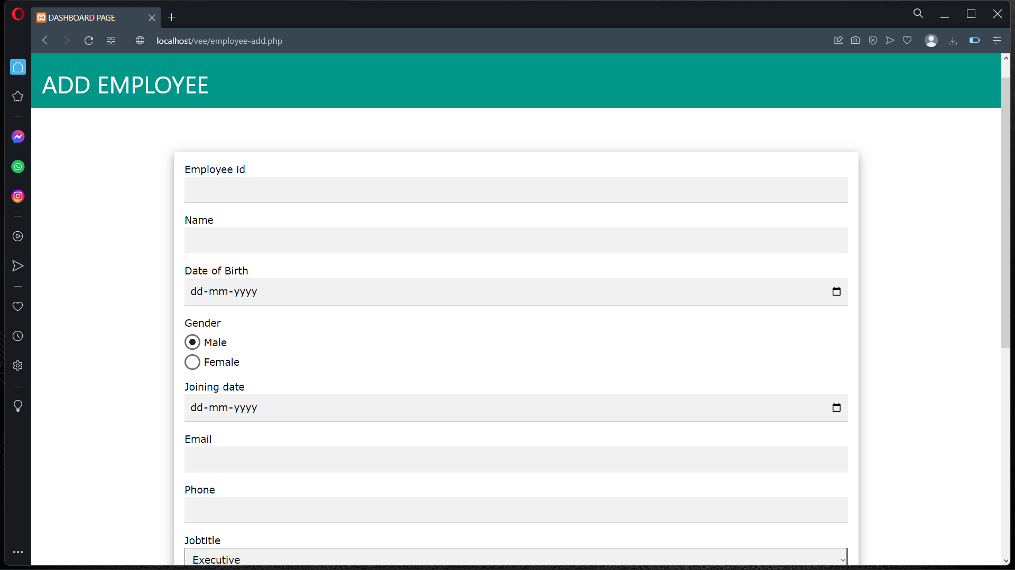
ADDING EMPLOYEE DETAILS

Slide 12
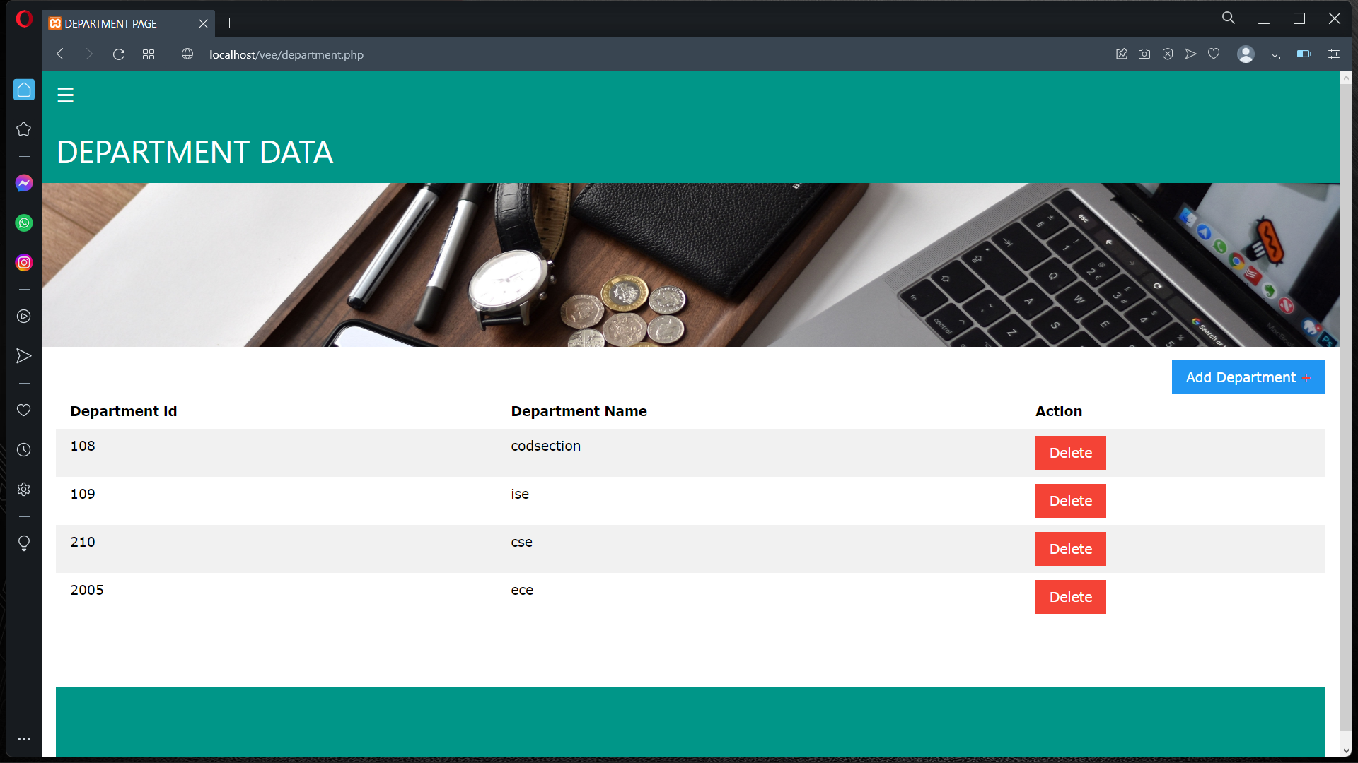
DEPARTMENT

Slide 13
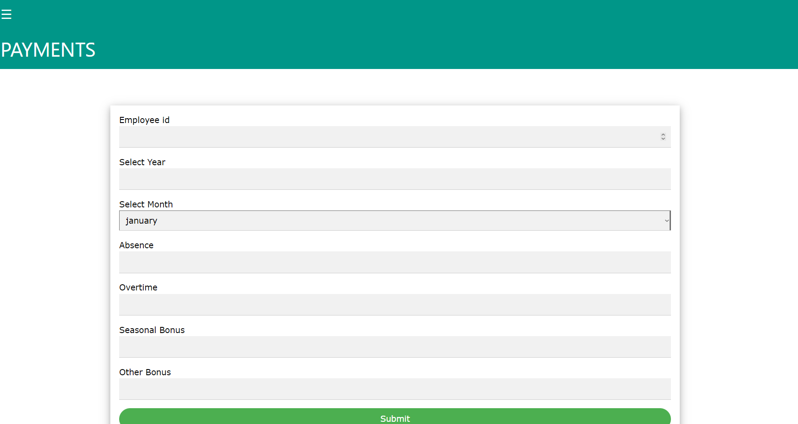
PAYMENTS

Slide 14
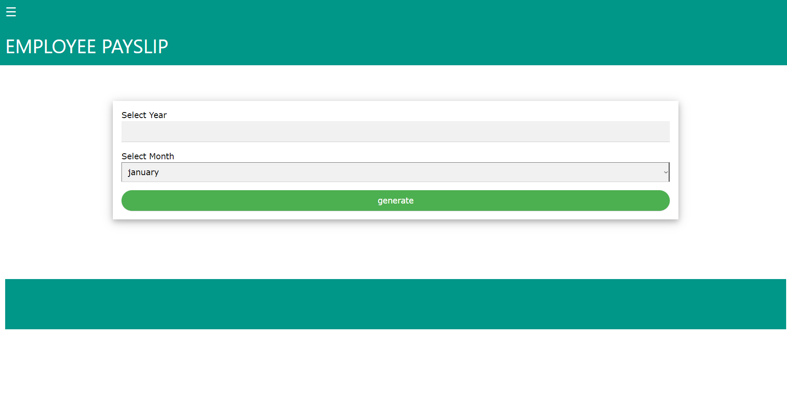
PAY SLIP

Slide 15
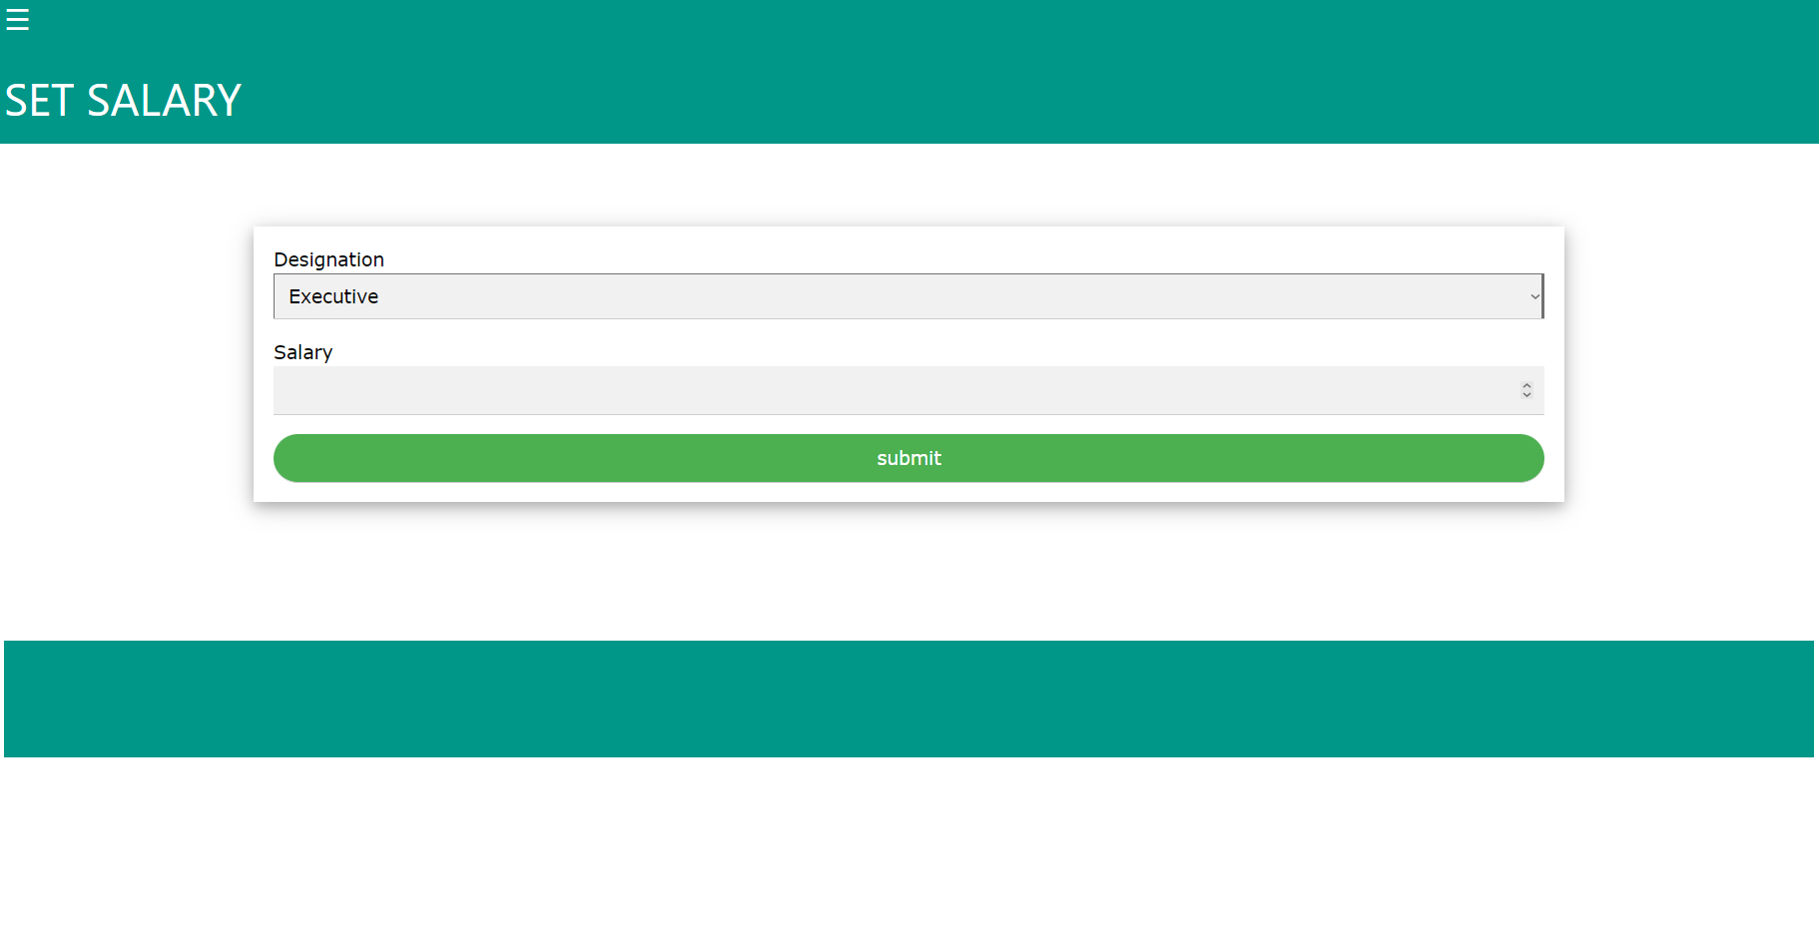
SET SALARY

Slide 16
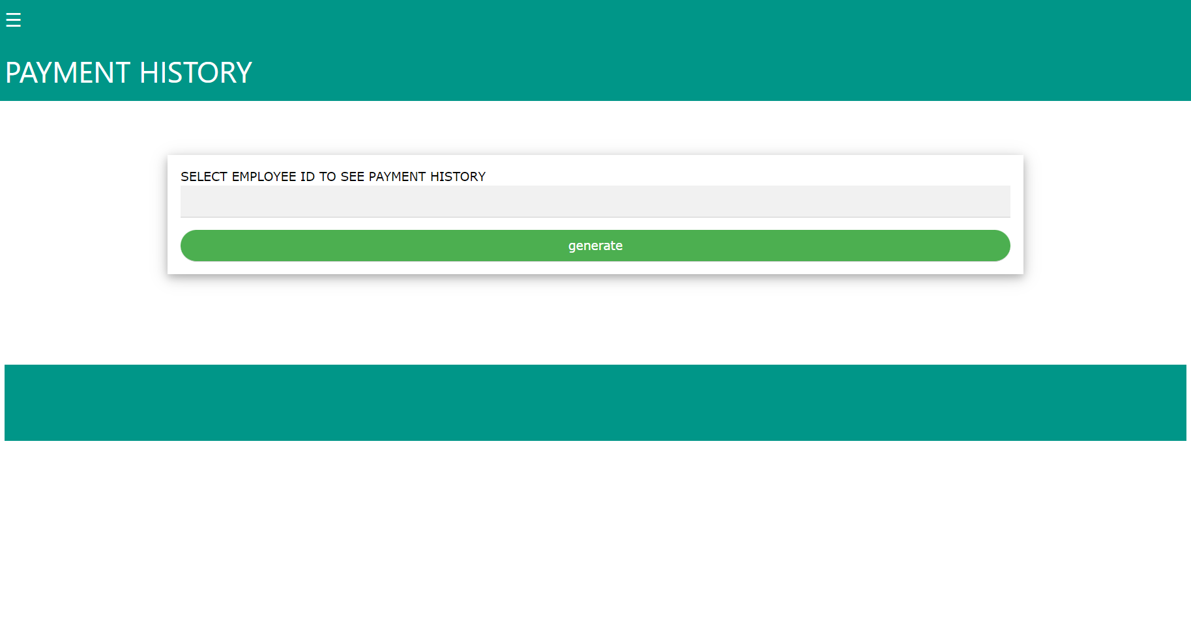
PAYMENT HISTORY

Slide 17
CONCLUSION
This project is built keeping in mind that it is to be used by only one user that is the admin. It is built for use in small scale organization where the number of employees is limited. According to the requested requirement the admin can add, manipulate, update and delete all employee data in his organization. The admin can add new departments and delete them.The required records can be easily viewed by the admin anytime time he wants in an instant. The payment of the employee is based on monthly basis. Numerous validations implemented would enable the admin to enter accurate data. The main objective of this framework is to save time, make the system cost effective and management records efficiently.

Slide 18
REFERENCES
Websites:
www.w3schools.com
www.youtube.com
www.google.com

